Slide 1
Analysis of Uber data in New York City
By: Abdulrahman Alsalamah

Slide 2
Outline
Uber company.
What is the project ?
EDA
Visualization
Time Series Analysis
Conclusion and recommendations

Slide 3

Uber company.
Uber For Riders is
a taxi service.
provide private drivers
Uber For drivers
provides exceptional pay.
flexible work
Notes:
Hi

Slide 4

What is the project ?
Analyze
Analyze Uber data in New York city.
Visualize
visualize the traffic in New York city .
Predict
Predict the future order in time series

Slide 5
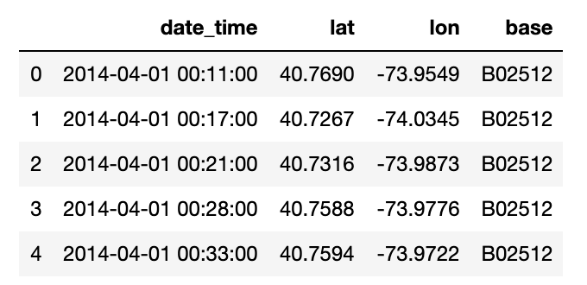
EDA
The data clean.
More then ½ million rows for Apr 2014

Slide 6
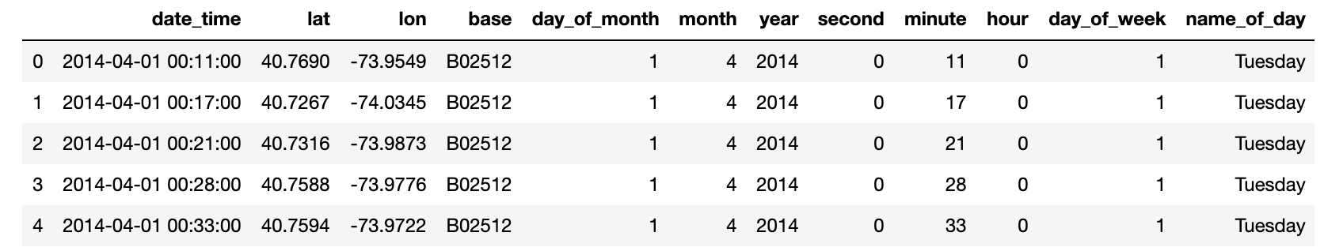
after EDA

Slide 7
visualization

Slide 8
visualization

Slide 9
visualization
Visualize New Your city

Slide 10
Interactive visualization
Jupyter notebook

Slide 11
Time Series Analysis
Collect data from Apr to Sep in 2014
About 5M rows of data
Some distinguishable patterns appear when we plot the data

Slide 12
Time Series Analysis
The time-series has seasonality pattern, such as order are always low at the weekend high at the working day.
There is always a strong upward trend within any single week
decompose time series into three distinct components: trend, seasonality, and noise

Slide 13
forecasting with ARIMA
The output suggests that ARIMA(1, 1, 0) x (1, 1, 1, 12) yields the lowest AIC
We consider this to be optimal option.

Slide 14
forecasting with ARIMA
predict orders the in the next 4 month with ARIMA
Uber market increase with time

Slide 15
Conclusion
Working day
Weekend
Traffic in New Your city
Increase in Market

Slide 16
recommendations
the police department must be expected to be traffic in some specific time
Direct the driver for location
provide share car

Slide 17
Thank you

